Slide 1
No more trade-offs:
Over-parameterized, overfitted and still beautiful
Panagiotis Papasaikas
Advance single cell genomics course
02-09-2021

Slide 2

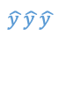
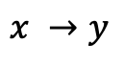
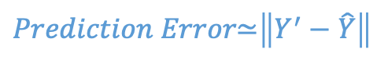
Bias-Variance decomposition
x’
x’
x’
$$x →y$$
$$\hat{y }\hat{y }\hat{y }$$
Train
Test
$$Prediction Error\text{≃}\left\|Y^{′}−\hat{Y}\right\|$$
$$Prediction Error=BiasError+VarianceError+Irred.Error (BayesError)$$
Modelling assumptions
(too rigid)
High sensitivity
(not rigid enough)
Noise
F(x)
High Training Error
Bias (Underfitting)
Low Training Error
High Test Error
Variance (Overfitting
/ Loss of Generalization)
Only Irred. Error
Bayes limit
High bias
High variance

Slide 3
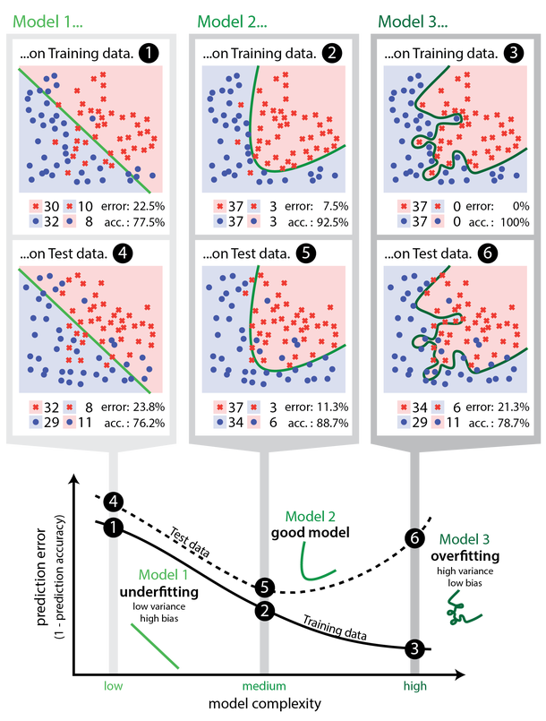

Bias-Variance tradeoff
So how do we increase the number of model parameters (p) while preventing overfitting?
Increase training set (n >> p)
Use regularization
(penalize for the number and/or for the magnitude of the model parameters )
Too few parameters
“Just right”
Too many parameters
Low variance, high bias
High variance, low bias,
poor generalization
Underfitting
Overfitting
Under-parameterized
Over-parameterized
Expands the selection of model class while keeping the effective model complexity low
“As the model capacity increases, so does its variance, its potential to overfit and its generalization error”

Slide 4
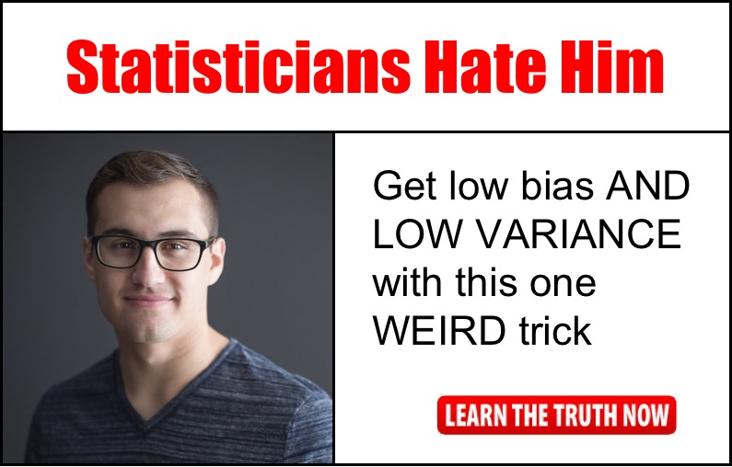


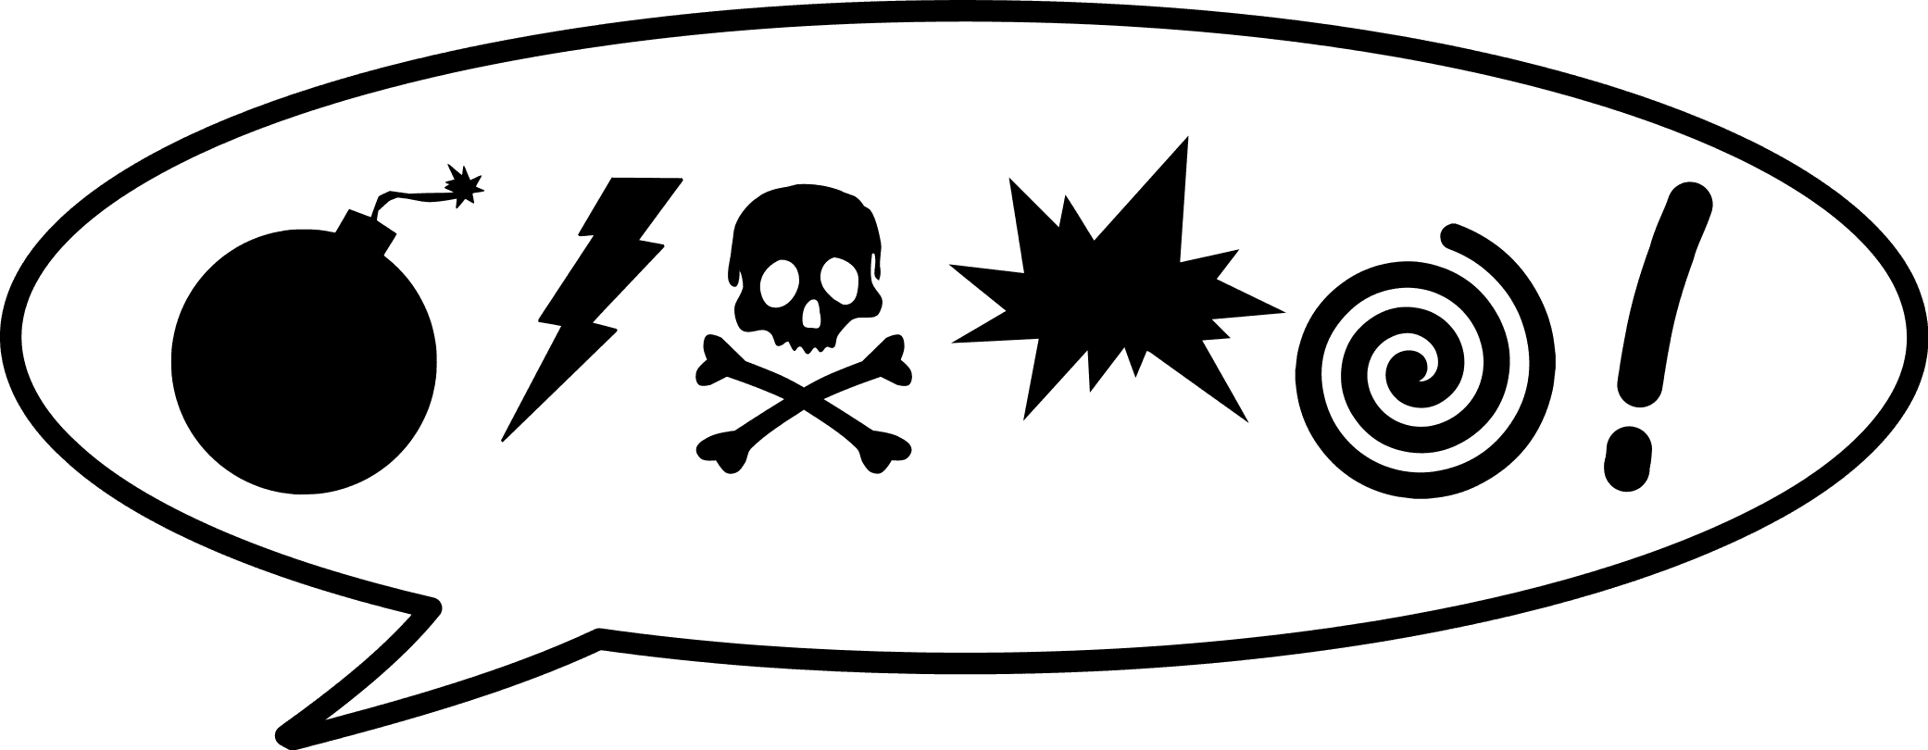
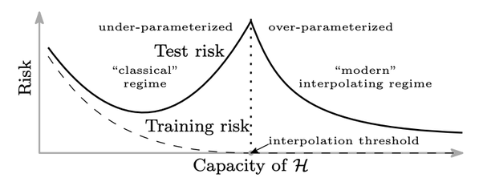

The “unreasonable” success of deep-learning models
and the “double descent” curve
Early criticism for ANNs:
Fully connected architectures have an unreasonably high number of parameters.
-> Therefore, in order to train them you need unreasonably large training sets.
Geoffrey Hinton:
“In your lifetime you make on average 10billion
fixations yet you have abouth 10,000
more synapses than that, so you don’t
satisfy statistics 101 either”
Variance appears to decrease with model complexity beyond the IP
Modern deep learning models are hugely overparameterized (p >> n)
Actually in several instances they appear to be completely overfitted (even in the presence of noisy / mislabelled data)
However, their generalization performance is extremely good
Overfitting is not necessarily harmful
The “double descent”
curve:
Since the IP threshold is at p=n does that mean that in some cases more data can hurt us?

Slide 5
Demonstration

Slide 6

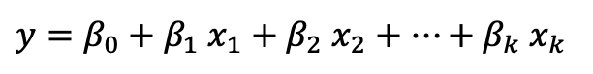

Task: Predict scalar y from multiple weak predictors x_{i}
x¹
x²
x³
…
x²⁰⁴⁸
Try linear regression with different number of parameters
y
$y=β_{0}+β_{1}$ $x_{1}+β_{2} x_{2}+…+β_{k} x_{k}$
Try MLPs with different number of parameters hidden layers
Simulated data:
y
x, x=y+e, e~N(0,1)
x
x^{i}, x^{i} =x+e’, e’~N(0,2)
X
$$\hat{ y }$$
X
$$\hat{ y }$$
p=2048, n=2000
Compare performance on training, validation sets
Also create using the same procedure a validation set
X_{v} , Y_{v}

Slide 7
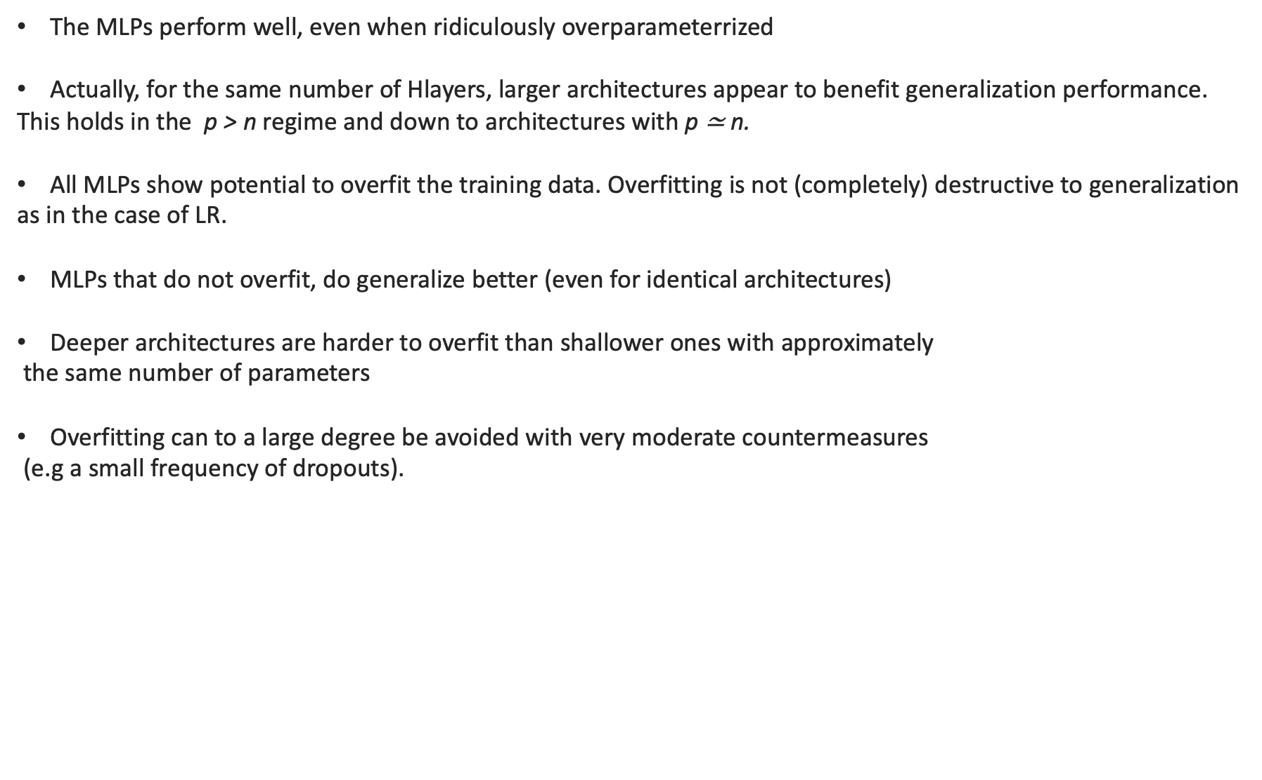
Summary of observations
The MLPs perform well, even when ridiculously overparameterrized
Actually, for the same number of Hlayers, larger architectures appear to benefit generalization performance.
This holds in the p > n regime and down to architectures with p $\text{≃}$ n.
All MLPs show potential to overfit the training data. Overfitting is not (completely) destructive to generalization
as in the case of LR.
MLPs that do not overfit, do generalize better (even for identical architectures)
Deeper architectures are harder to overfit than shallower ones with approximately
the same number of parameters
Overfitting can to a large degree be avoided with very moderate countermeasures
(e.g a small frequency of dropouts).

Slide 8
What are the mechanics that drive performance improvement
in the overparameterized regime?
No violation of the spirit of bias-variance tradeoff. More complex models DO have
a higher variance upper-bound but that bound is not realized.
It’s the dynamics of the exploration of the optimization landscape by SGD that lead to ”smoother” solutions with low weight norms.
These solutions are more robust to input fluctuations and thus generalize well
Even in the cases of complete overfitting, the solutions are smooth (benign)
Overparametrization is essential for “benign” overfitting.
This effect of the specific optimization procedure is referred to as “implicit regularization”.
In a way analogous to classical regularization it expands the selection of model class while keeping the effective model complexity (intrinsic dimension) low.
Many open questions…

Slide 9
Summary
Increasing the number of model parameters increases the upper bound of its variance
Modern DL models are hugely overparameterized, often overfitted and yet they generalize well
This apparent discrepancy boils down to the mechanics of fitting DL models:
Optimization landscape + optimization via SGD favors “smooth” solutions with small norms
This implicit regularization via SGD in the p>n regime keeps the variance in check
and the higher the number of parameters the more potent its effect.
Even when DL models do overfit, they appear to do so in a relatively “benign” manner without hurting too much their generalization performance.
What does it mean in practice?
When it comes to choosing architectures, do not afraid to go bigger (or rather deeper)
Utilizing additional measures to avoid overfitting (e.g dropouts, regularization) is also not a bad idea
It’s ok, humans still satisfy statistics 101 ☺

Slide 10
References and resources
Reconciling modern machine learning practice and the bias-variance trade-off
https://arxiv.org/abs/1812.11118
A Modern Take on the Bias-Variance Tradeoff in Neural Networks
https://arxiv.org/abs/1810.08591
Deep bouble descent: Where bigger models and more data hurt
https://arxiv.org/pdf/1912.02292
and commentary:
https://www.kdnuggets.com/2020/04/double-descent-hypothesis-bigger-models-more-data-hurt-performance.html
Understanding deep learning requires re-thinking generalization
https://arxiv.org/pdf/1611.03530.pdf
Surprises in High-Dimensional Ridgeless Least Squares Interpolation
https://arxiv.org/abs/1903.08560
Intrinsic dimension of data representations in deep neural networks
https://arxiv.org/abs/1905.12784
How benign is benign overfitting?
https://arxiv.org/abs/2007.04028
and presentation:
https://www.stat.berkeley.edu/~bartlett/talks/201908Microsoft.pdf
Two models of double descent for weak features
https://arxiv.org/abs/1903.07571
Generalization Error in Deep Learning
https://arxiv.org/pdf/1808.01174
On the Bias-Variance Tradeoff: Textbooks Need an update:
https://arxiv.org/abs/1912.08286
https://www.bradyneal.com/bias-variance-tradeoff-textbooks-update

